Slide 1
Commercial Bank Marketing Campaign
Portuguese Banking Institution
Jiangningzi
(Lydia) Li
October 2022

Slide 2
Agenda
Part 1- Client Demographic
Part 2- Results from the Last Campaign
Part 3- Analyzing Customer Persona
Part 4- Recommendation: targeting on future client
Part 5- Q & A

Slide 3
Executive Summary
Predictive model
Product: Bank Term Deposit
Ads Channel: Phone Calls
Quantities of Future Clients : 42,600 people, 17 variables (prespections)
Marketing Strategies
Goal: increase conversion rate from Phone Call to make a term deposit
Customer Persona: Who the Customers is?
Paint Point: What is holding them back from making a term deposit?
Optimizing sales call activity via random forest in Python/ R
Notes:
The Marketing Campaign of Portuguese Bank Institution project conducts an exploratory data analysis and develops multiple classification models for optimizing sales call activity by using random forest via Python or R to analyze and develop a predictive model. Minimize classification errors that cover 17 variables covering client data (8 variables) and campaign data (9 variables) and come out with strategy recommendations including the clients' demographics, the main characteristics in each target segment, the analyzing results from the current campaign, and a practical go-to-market plan for how to approach future clients.

Slide 4
Marketing Tactics
Awareness
Campaign results
group by “Yes”
to located Subscribers
Consideration
clients’ action
Paint points
Conversion
From Phone calls to deposit
Loyalty
REPEAT Deposit

Slide 5
Part 1 - Client Demographic
Part 1- Client Demographic
Who are the “potential client”:
Subscriber on term deposit
Age around 40’ (age 30 to 49 years old)
Marriage Status is “Single” or “Divorced”
Good Credits Report (Defraud)
No Loan
No Housing
Work as Management or Technician
Achieved Secondary degree (High school)
Bank Balance <500 ERU or >2500 ERU
Notes:
The purpose of today's discussion is to share predicting insights of our potential client from the last campaign.
Before we dig into that, let's do a recap of the client demographic. Focusing group on Variable - y - has the client subscribed to a term deposit? ("yes","no")

Slide 6
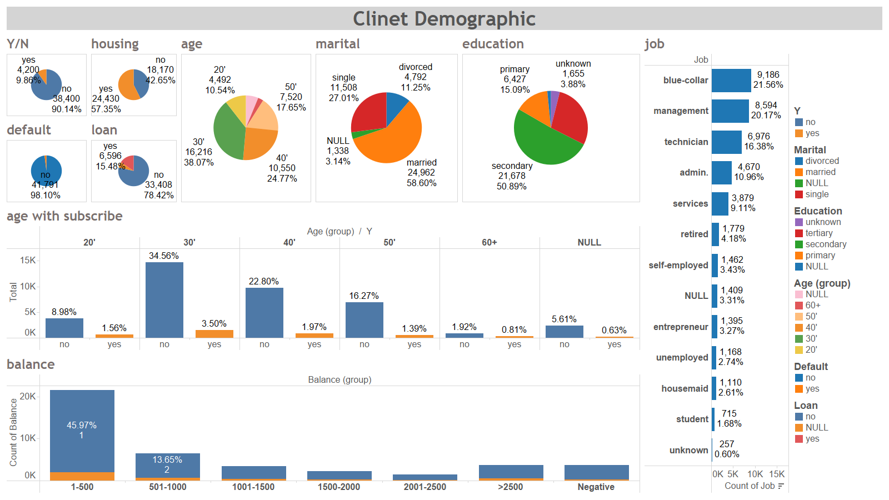

Slide 7
Part 2- Results from the Last Campaign
How to approach the client:
Call 1 times before during the last campaign
Contacted on last campaign 4 months ago
April to August
Every Week 3 of the month
Call to Cell Phone
Follow up 1-2 calls
Time Duration for call within 3-6 minutes
No longer than Ave. 400 seconds call durations
Notes:
This is the outcome of the previous campaign
With a total of 42600 people.
There are about 10% subscribed to our products (term deposit).
Since our discussion purpose is to look the factors that encourage people to subscribe to our products.
For the rest of the discussion, we will be focusing on the 4200 subscribers.

Slide 8
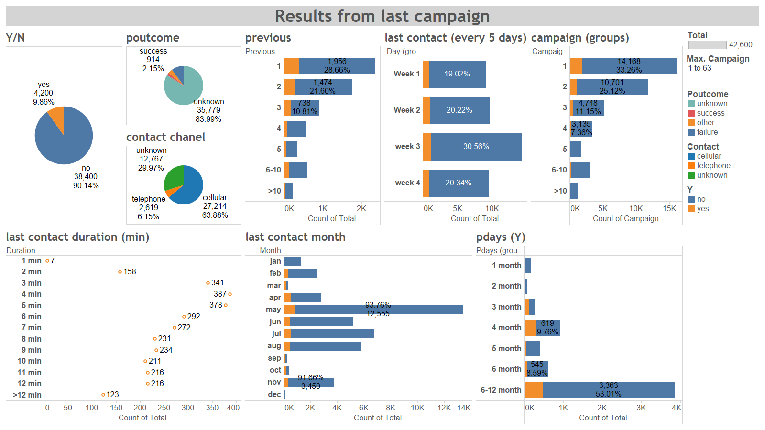

Slide 9
Part 3- Analyzing Customer Persona
Who are the “perfect client”:
Subscriber / Non-subcriber
Age around 20’ / 30’ / 40’ / 50’ /60’ /70’+
Marriage Status
Credits Report (Defraud)
With Loan / No Loan
Household / No Housing
Working industries
Achieved 1st/ 2nd /3rd degree
Bank Balance Range
How to approach the “perfect client”
Contacted on last campaign
Call times before last campaign
Call times during the last campaign
Call on month
Call on days (in weeks range)
Previous call by telephone/cells/unknown
Follow up calls by times
Time Duration in seconds
Notes:
1- Using Random Forest Model for the machine learning algorithm.
2- Combing the 17 variables decision trees.
3- Evaluate the total trees for taking a majority vote.
4- The greater the trees in the random Forest Model, the more actually the prediction will be.
Example Trees Shown below:

Slide 10
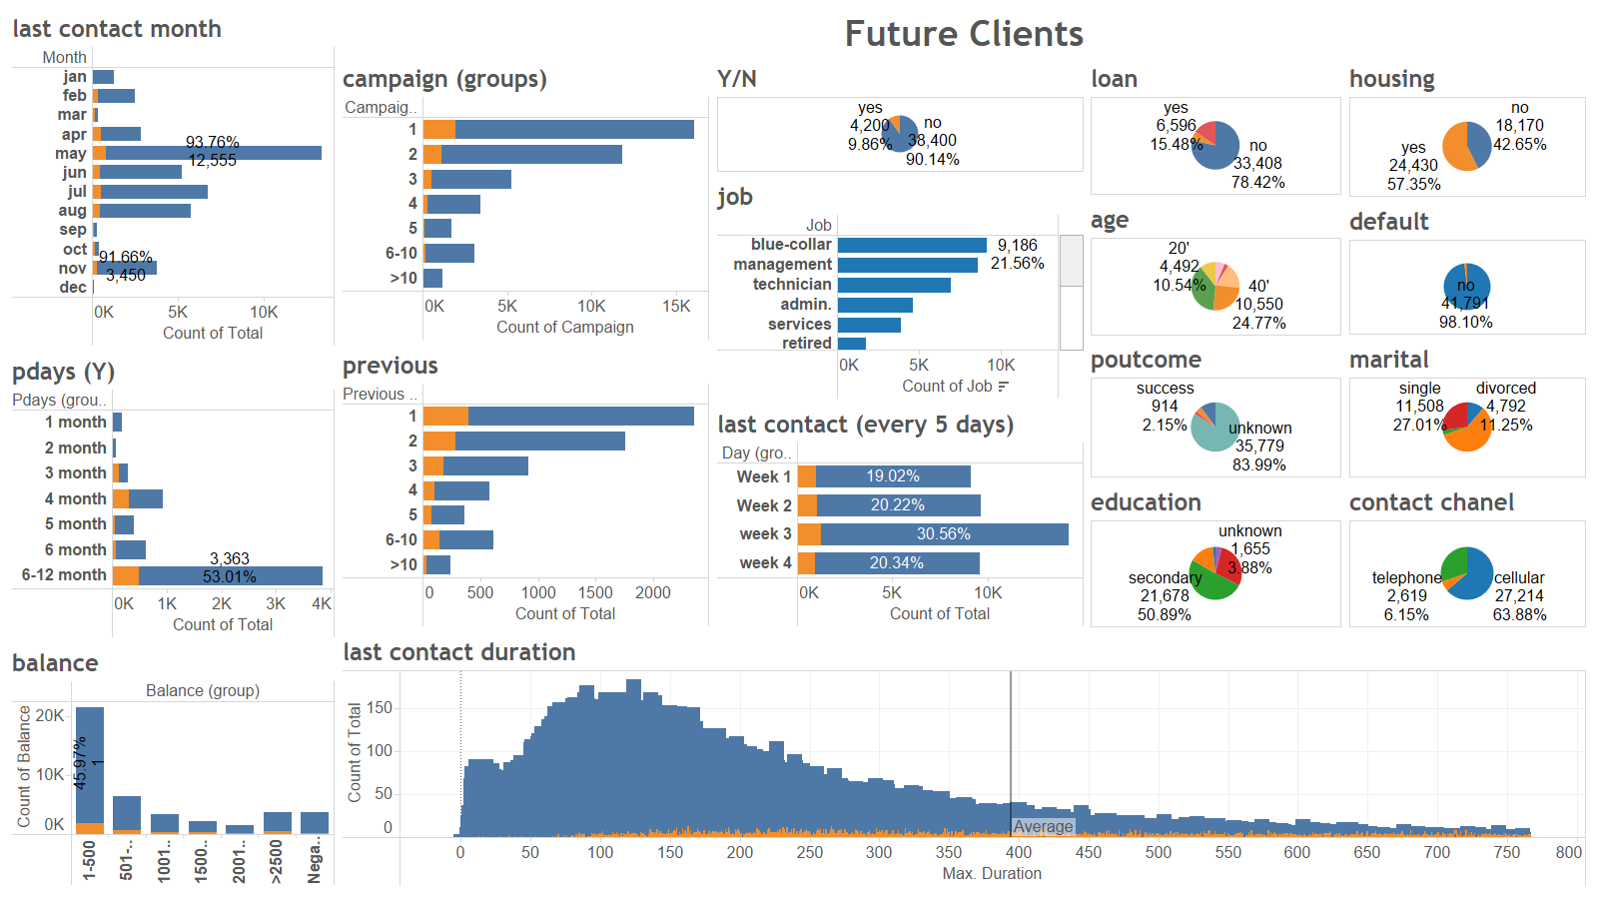

Slide 11
Part 4- Recommendation: targeting on future client
Who are the “perfect client”:
Subscriber on term deposit
Age around 40’ (age 30 to 49 years old)
Marriage Status is “Single” or “Divorced”
Good Credits Report (Defraud)
No Loan
No Housing
Work as Management or Technician
Achieved Secondary degree (High school)
Bank Balance <500 ERU or >2500 ERU
How to approach the “perfect client”
Call 1 times before during the last campaign
Contacted on last campaign 4 months ago
April to August
Every Week 3 of the month
Call to Cell Phone
Follow up 1-2 calls
Time Duration for call within 3-6 minutes
No longer than Ave. 400 seconds call durations
Notes:
***There is a huge opportunity for management and technician, who has the potential willing to subscribe and has cell-phone.
***With bigger pictures in strategy
we are not only going to focus on the client who has a lot of balance in our current deposit account.
People with low balances in the bank, but work in the management and technology industry might have more bank accounts than one.
For the business strategy, people who have less than 100 dollars in the bank account are actually in the management industry.
This means people have high incomes that might have the possibility to own several bank accounts.
We will try to contact people who have less balance in their bank account to transfer their term deposits from another bank to our bank.

Slide 12
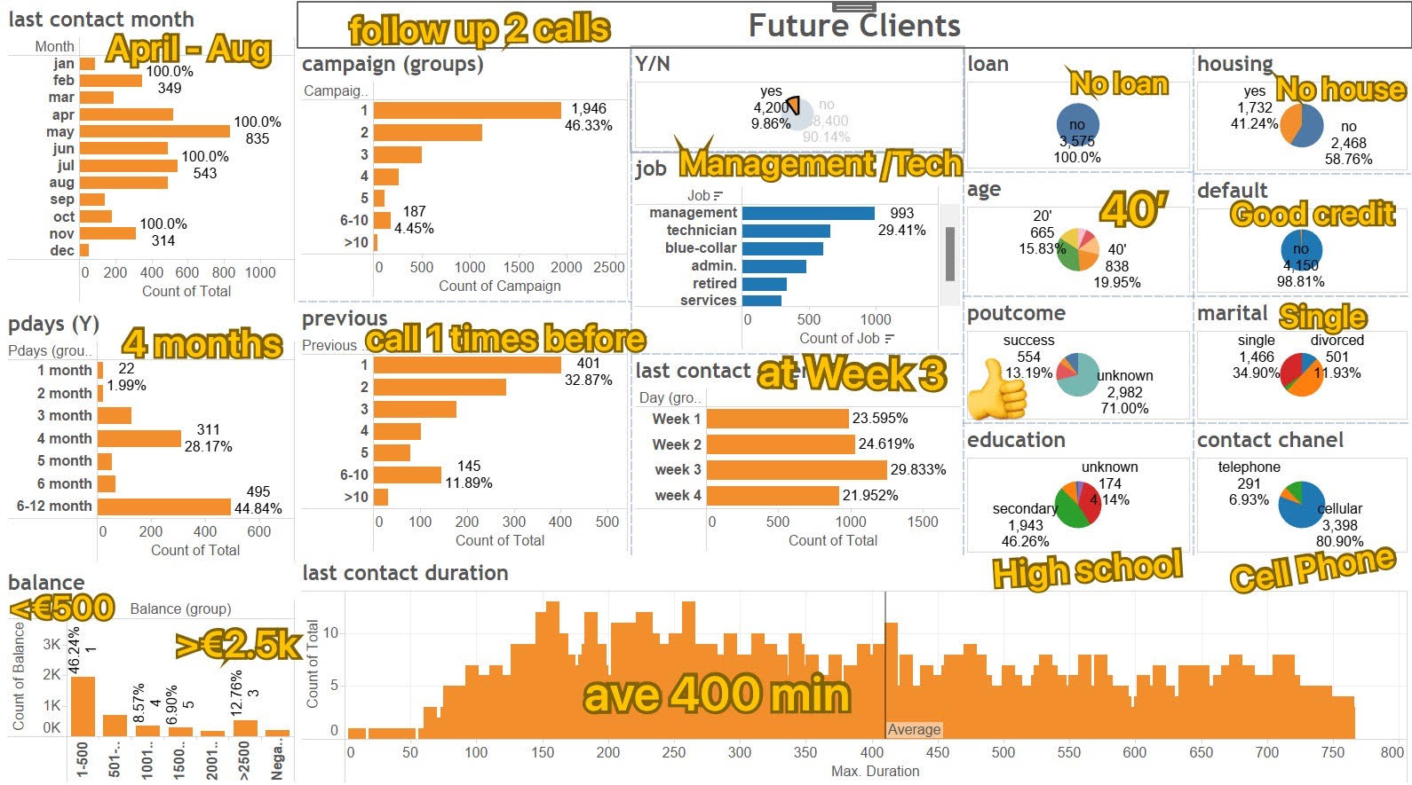

Slide 13
Part 5- Q & A
Contact Information: lijiangningzi@gmail.com
Package Available download in GitHub
https://github.com/lydiayes/Cemmercial-Bank-Marketing-Campaign

Slide 14
Reference Data Analyzing By Categories
Random Forest Model in Python/R/SQL
8 Variables Relative to Client Data
9 Variables Relative to Results of Last Campaign
Citation

Slide 15
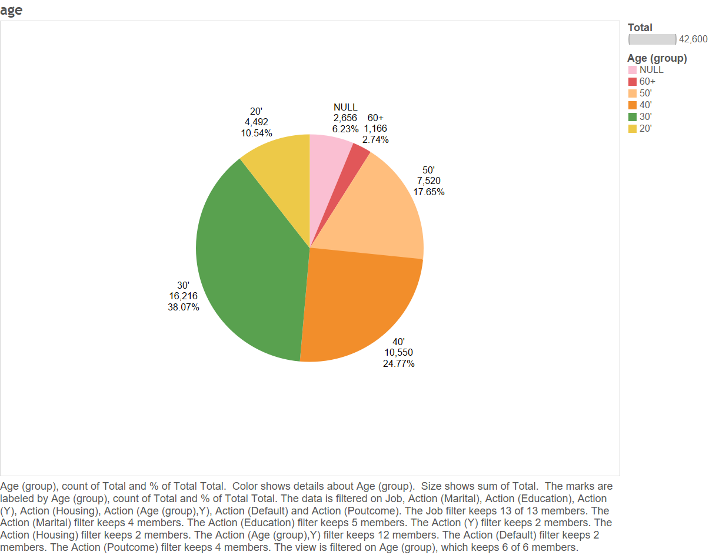

Slide 16
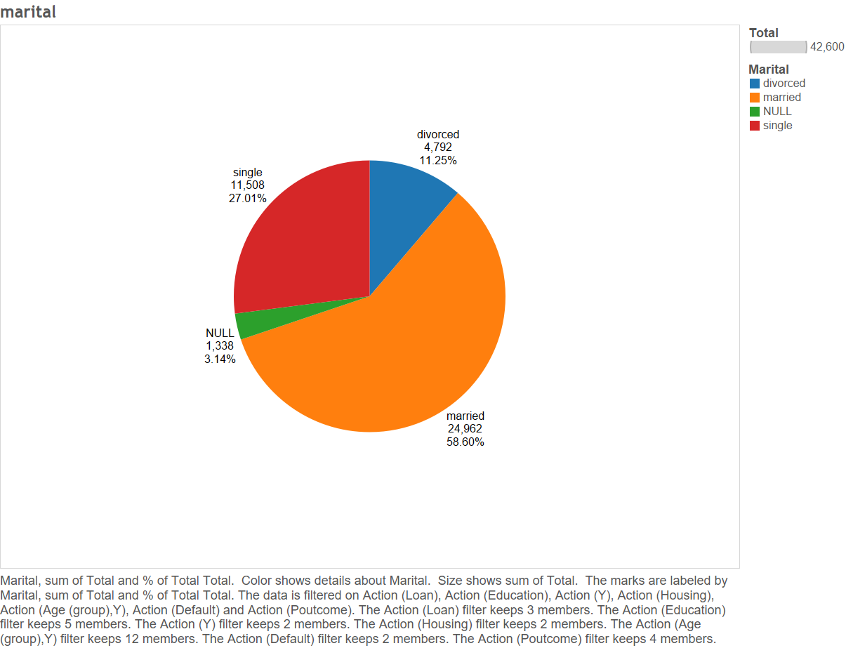

Slide 17
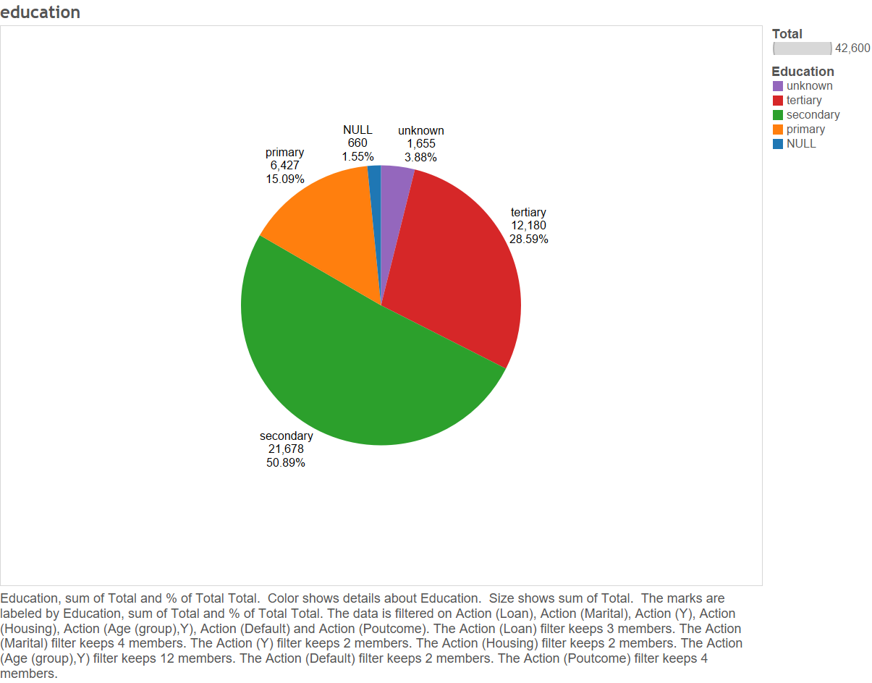

Slide 18
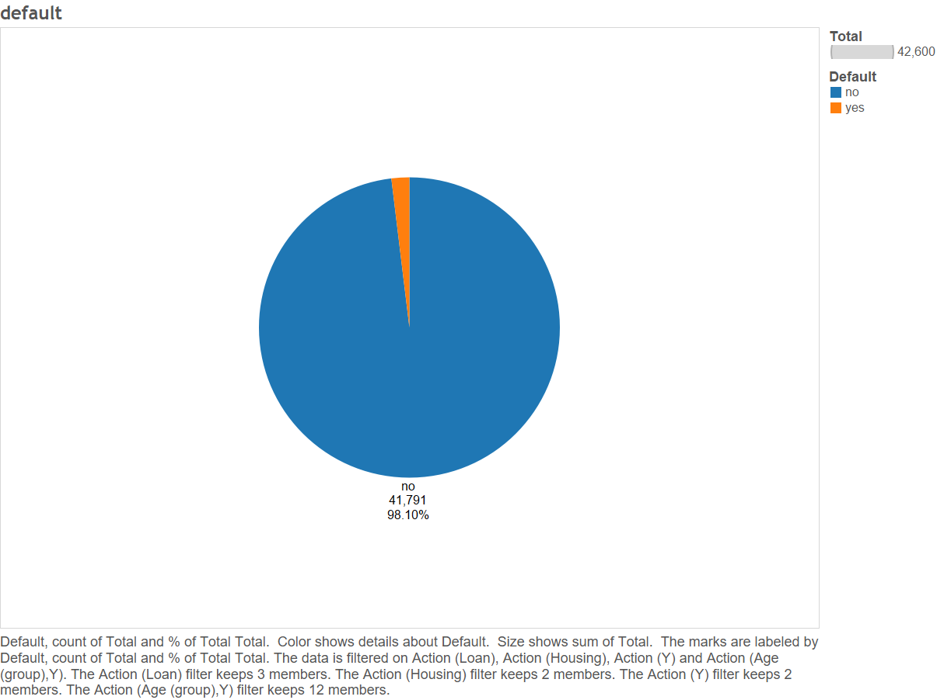

Slide 19
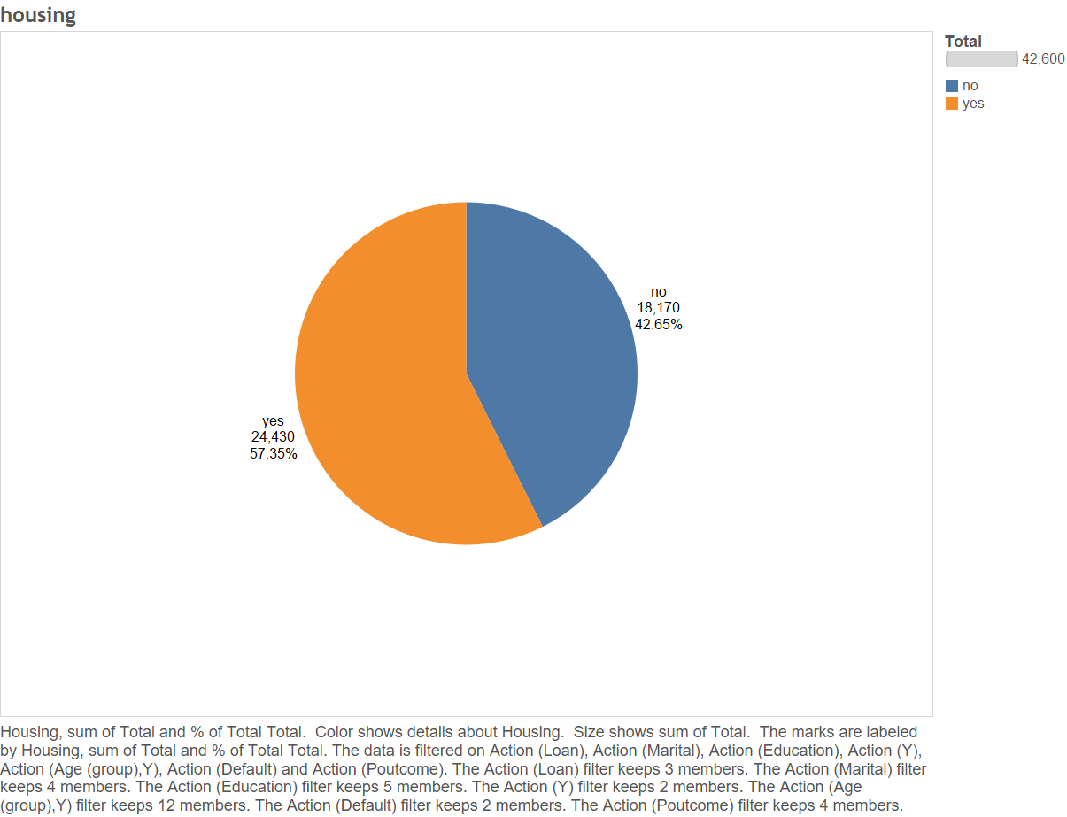

Slide 20
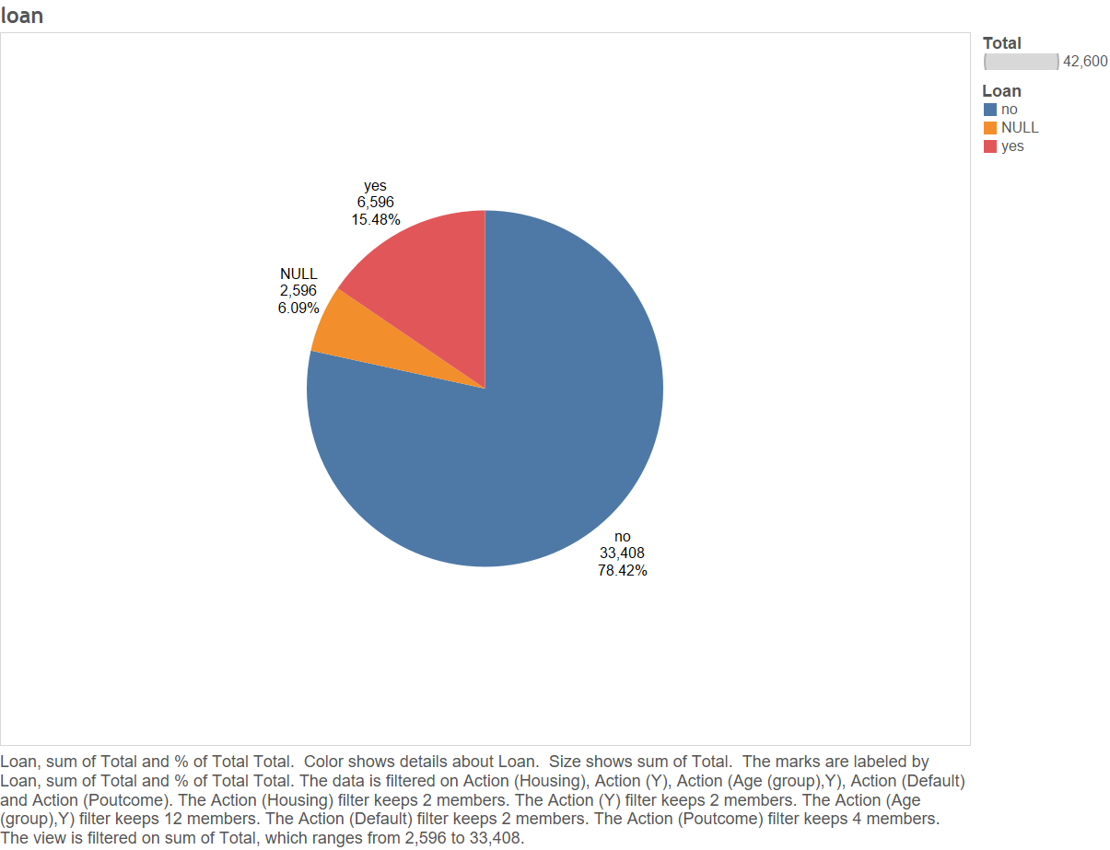

Slide 21
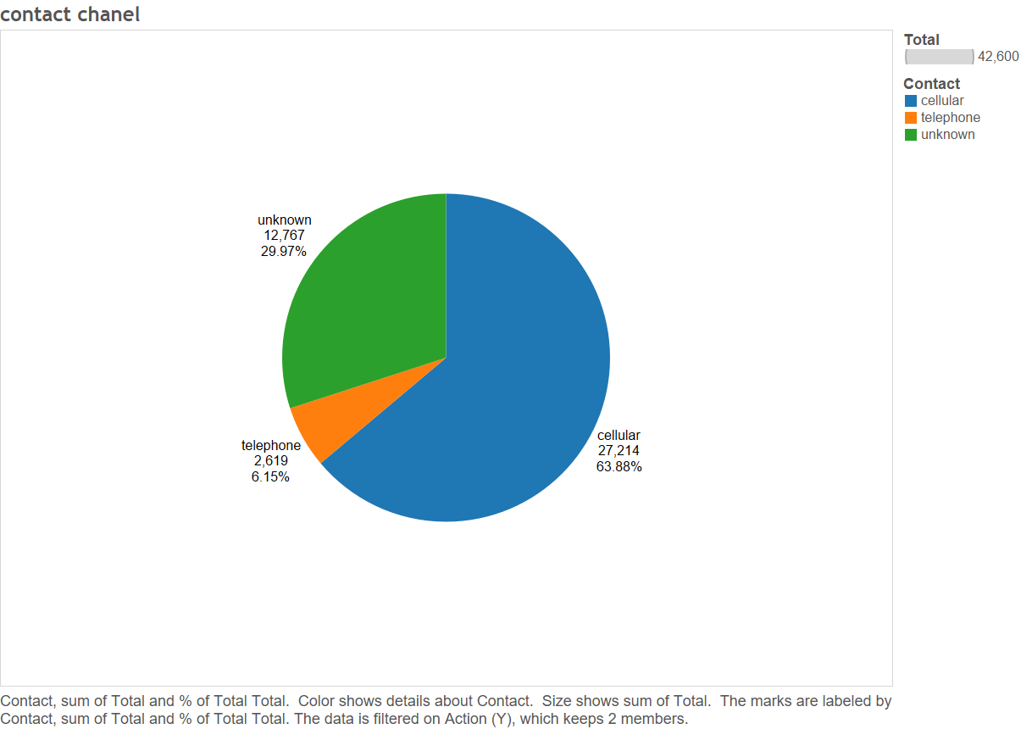

Slide 22
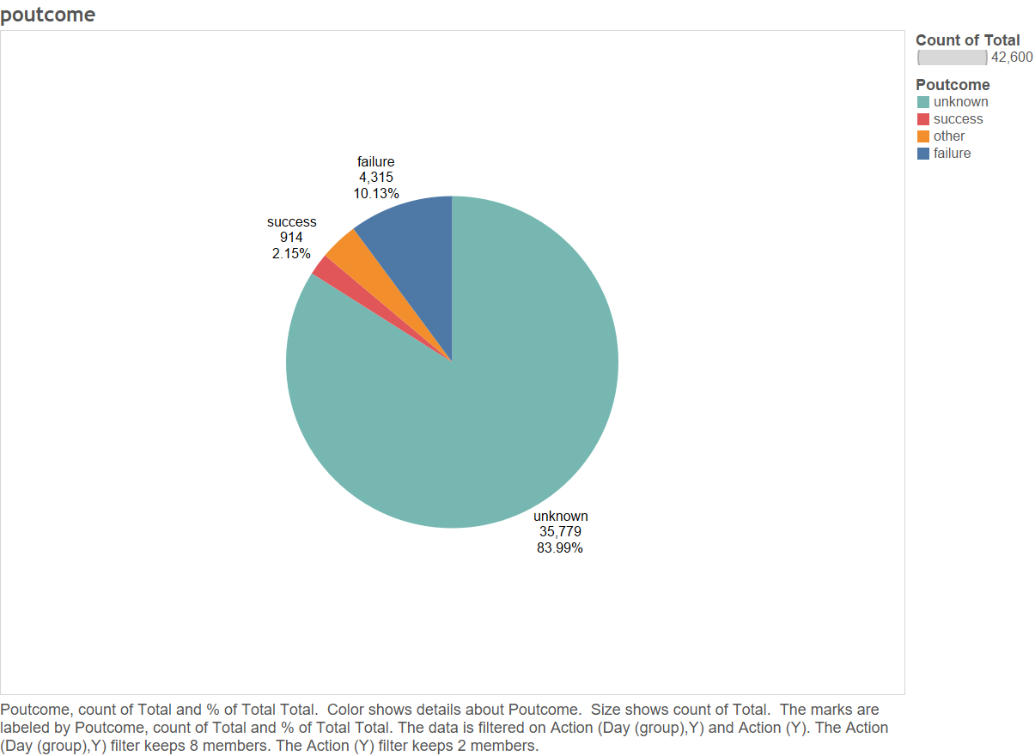

Slide 23
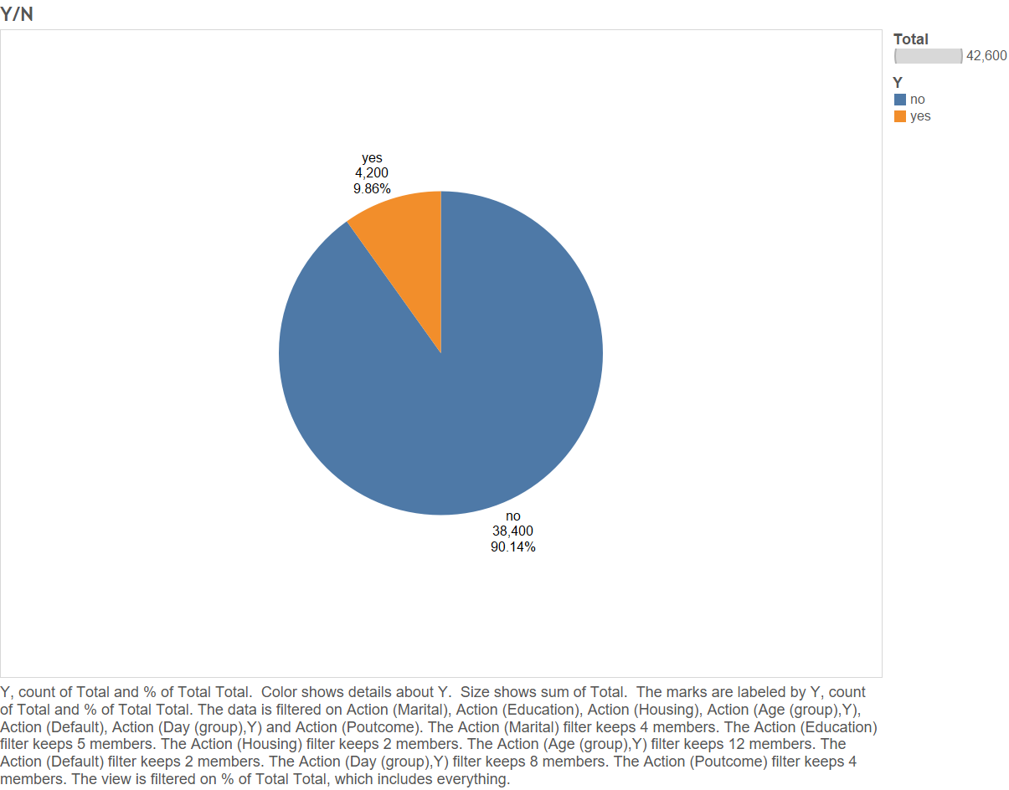

Slide 24
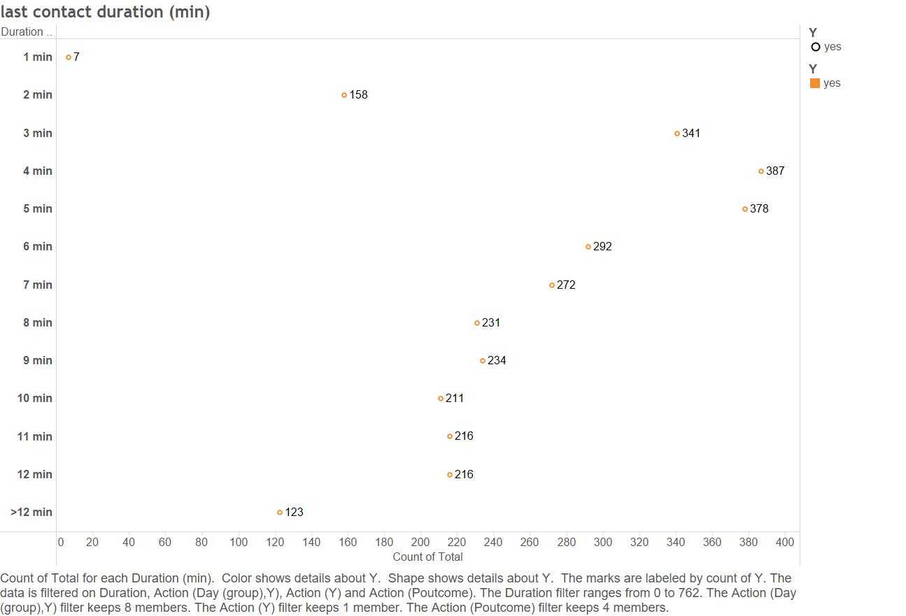

Slide 25
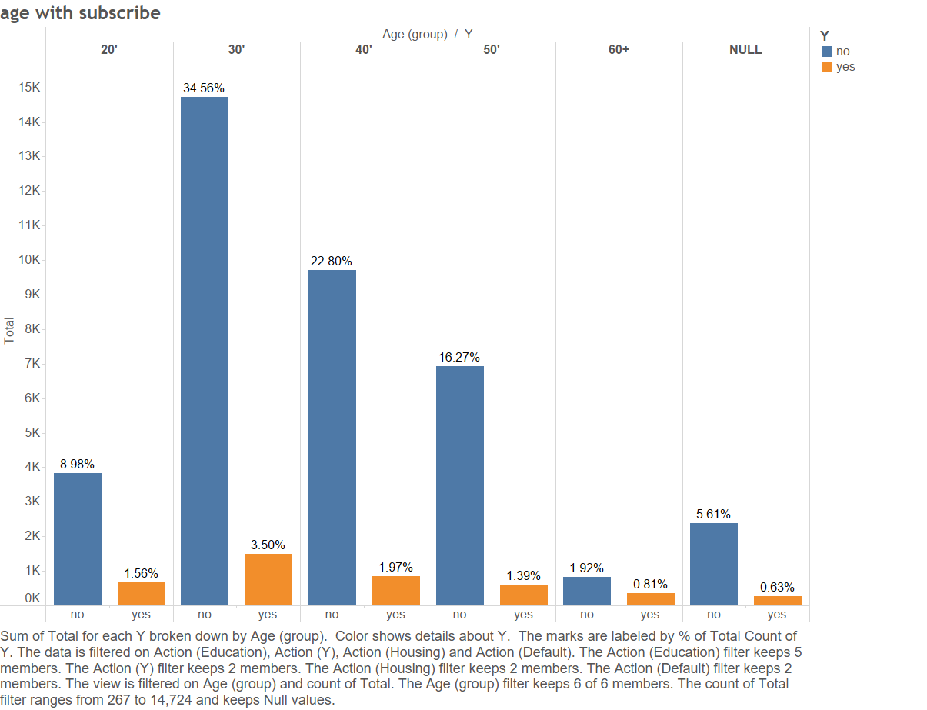

Slide 26
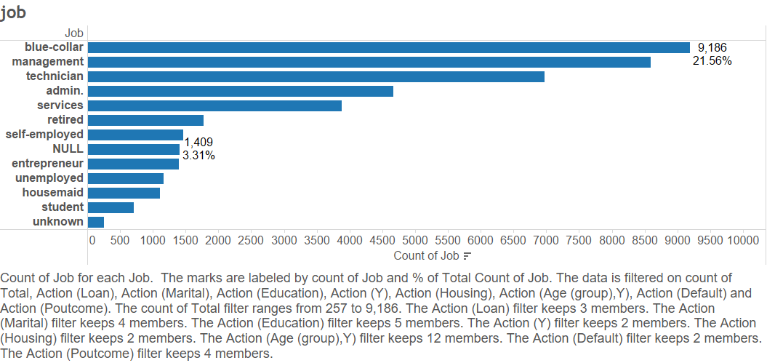

Slide 27
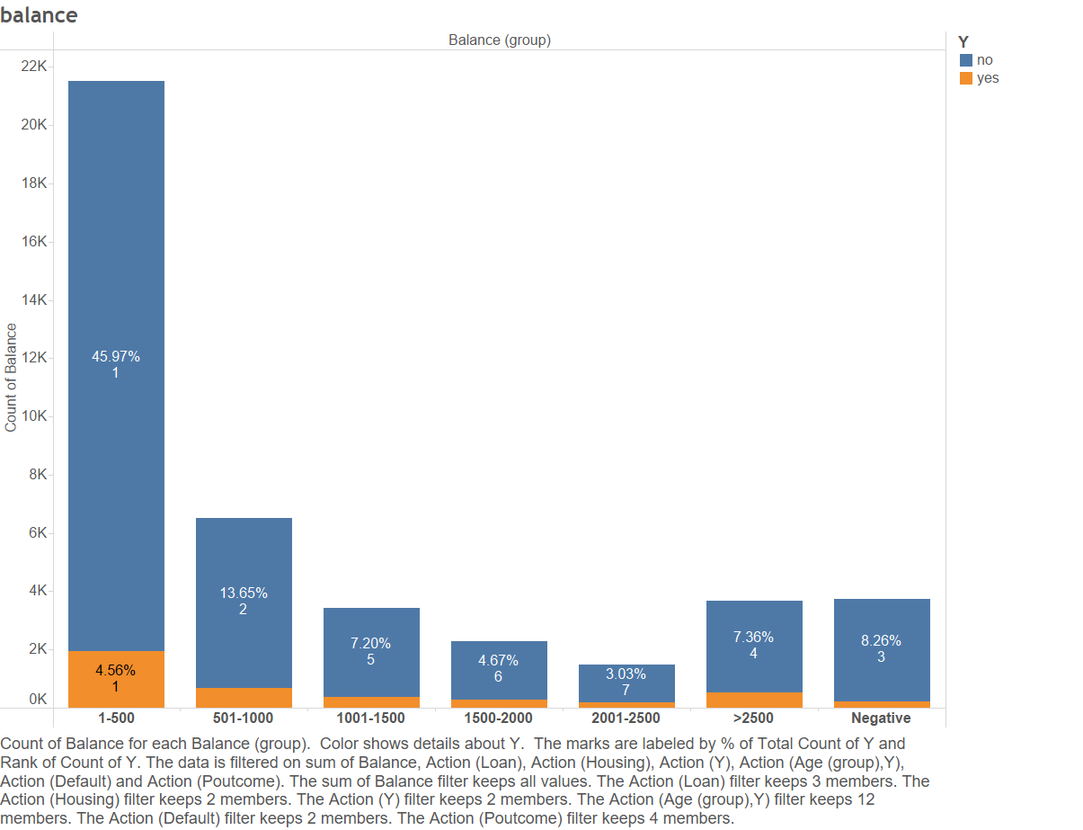

Slide 28
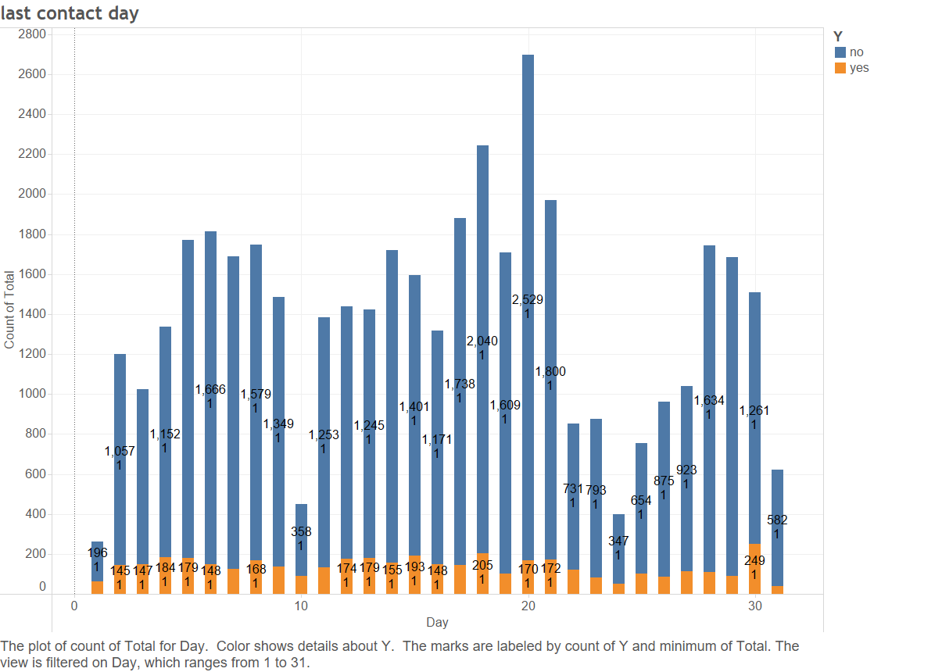

Slide 29
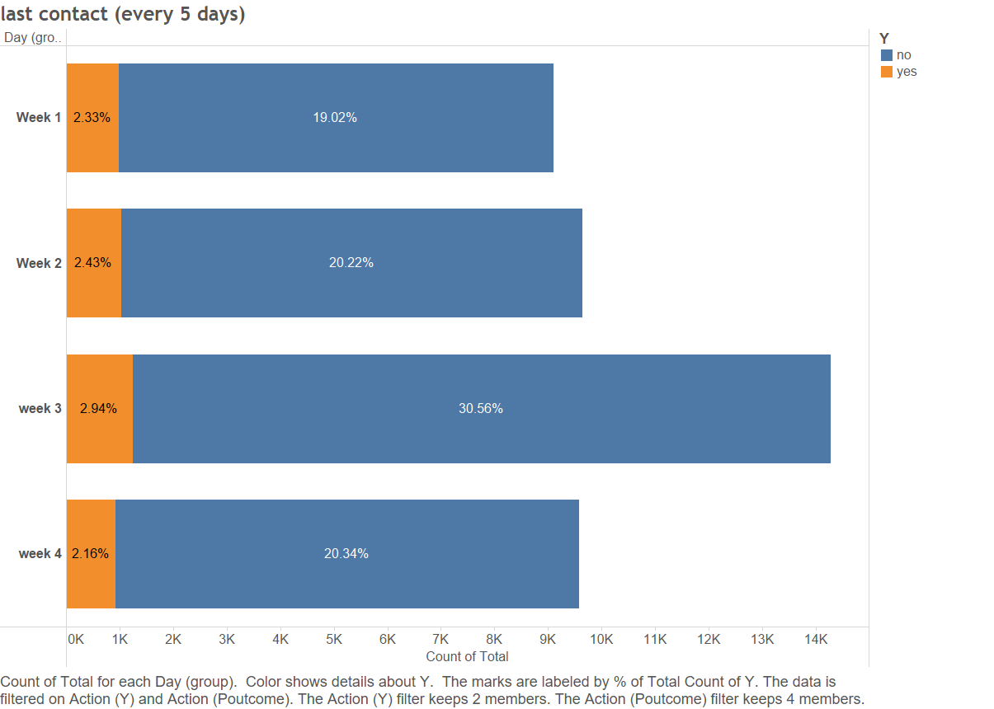

Slide 30
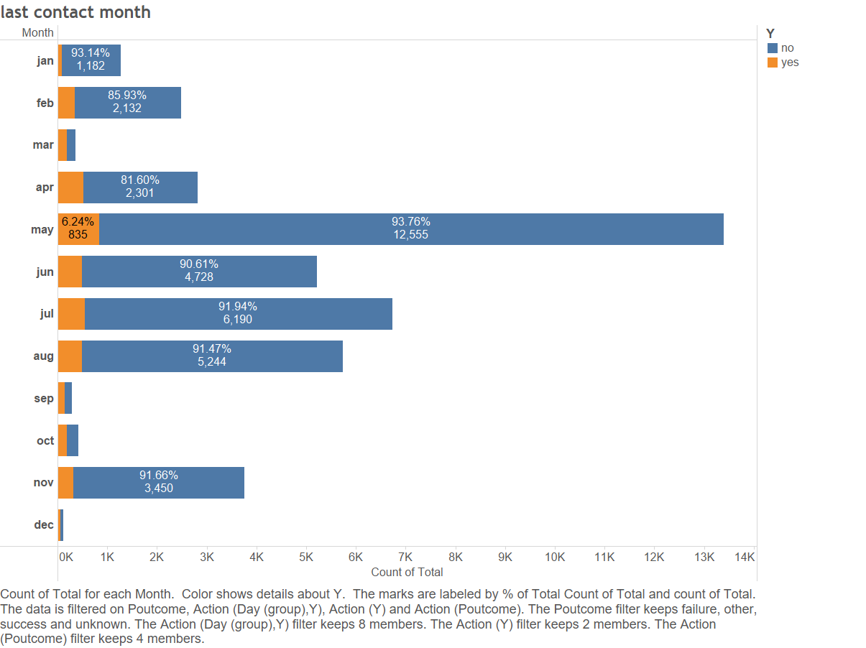

Slide 31
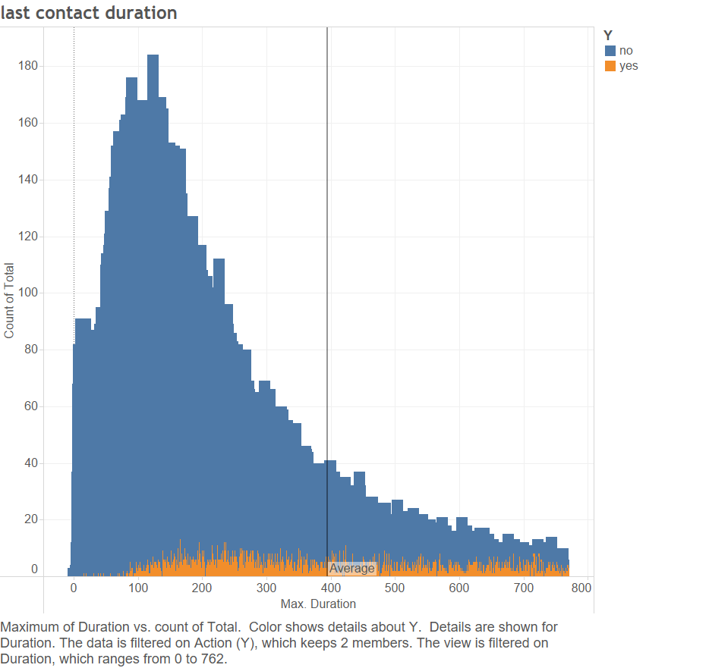

Slide 32
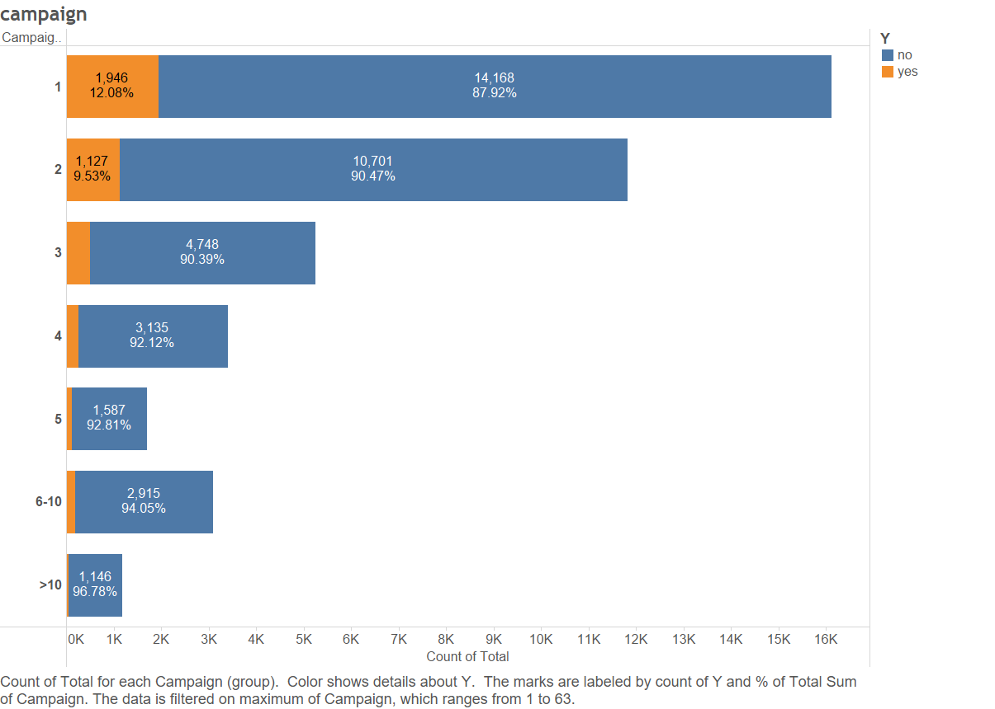

Slide 33
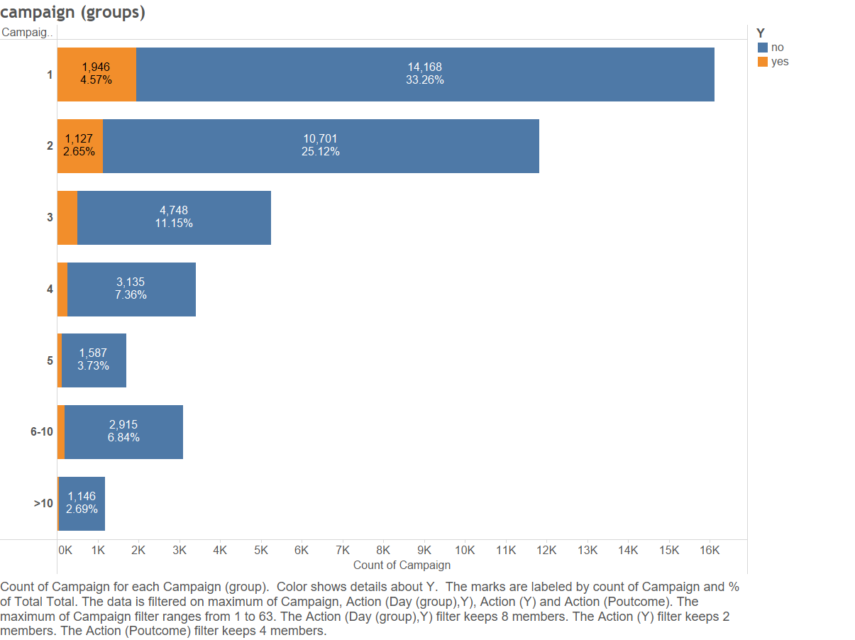

Slide 34
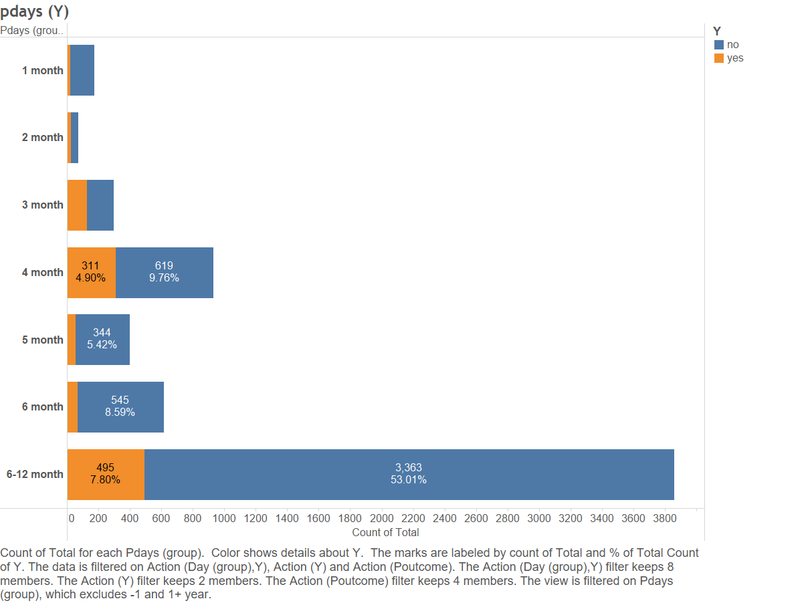

Slide 35
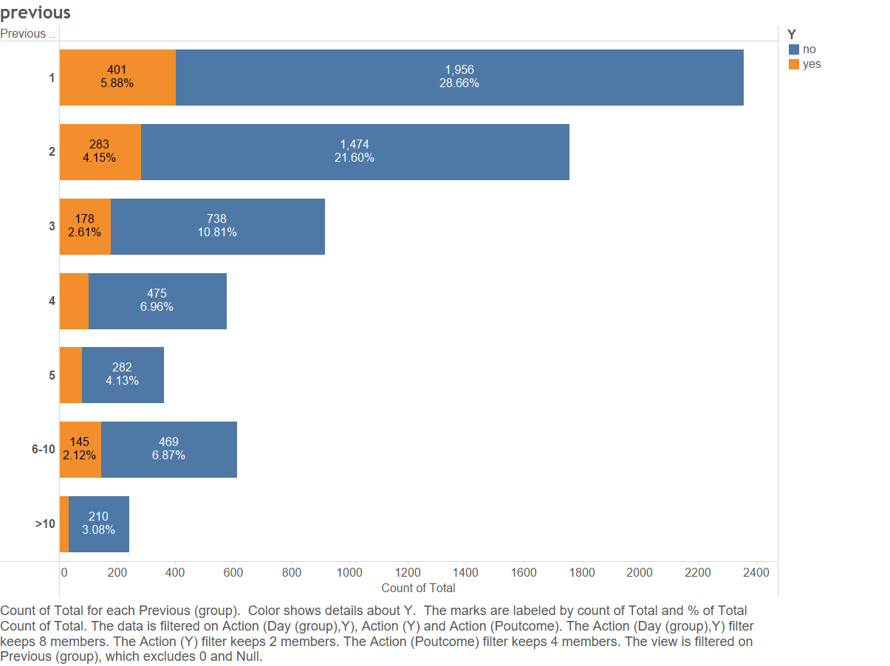

Slide 36
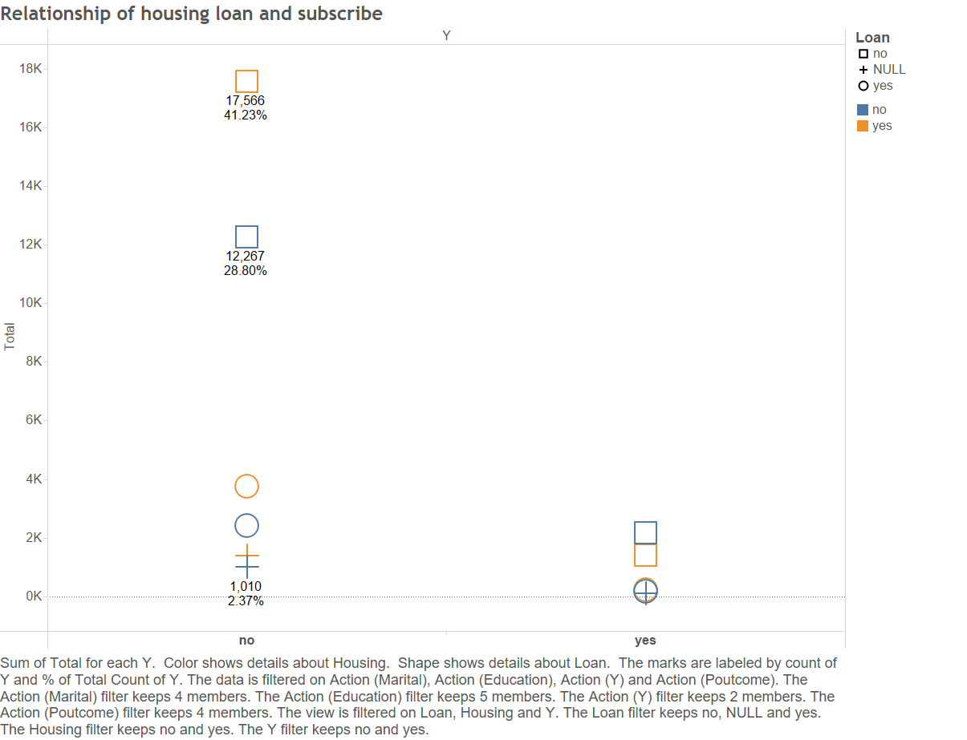

Slide 37
Citation
﻿ [Moro et al., 2011] S. Moro, R. Laureano and P. Cortez. Using Data Mining for Bank Direct Marketing: An Application of the CRISP-DM Methodology.
In P. Novais et al. (Eds.), Proceedings of the European Simulation and Modelling Conference - ESM'2011, pp. 117-121, Guimarães, Portugal, October, 2011. EUROSIS.

